Slide 1
PdfRename
Divyateja

Slide 2


Requirements
Original requirement: the pdfrename software should run flawlessly on Windows and Linux 3. On Windows: i. When you install the software using the standard installer package, it should first check if a previous version exists. If it does, it should overwrite. ii. The PDF Rename option should be added to the right click menu. iii. It should be possible to sequentially rename a bunch of files by selecting multiple pdf files (right click and drag). 4. On Linux i. The pdfrename command should be added to the command line path. ii. Installation should not require superuser permissions. It should check to see if $HOME/bin is in the path. iii. Should be possible to rename multiple pdf files at once: pdfrename *.pdf (for example) 5. On both: i. It should first check if the network is connected. ii. If not, it should indicate the same to the user, and ask if the user uses a proxy server. iii. If the user says yes to a proxy server, then it should check if it has stored details. If it does, then it should ask the user to confirm the details and ask if the details need to be changed. If the user says yes, then there should be an option to do so. The new details will be saved (there should be no need to enter this information every time). iv. There should be an option to "Retry" or "Cancel" at every point in this stage. 6. There should be detailed error messages for every exceptional condition. At no point should the program crash. 7. There should be no repetition of code. The pdfrename.sh script is very cluttered. Needs to be cleaned up. Other than a right mouse button click on Windows and typing pdfrename on Linux, the user should not need to do anything else.

Slide 3
Requirements Completed
Windows
With proxy
Without proxy
Linux
With proxy
Without proxy
Single pdf
Multiple pdfs
Single pdf
Multiple pdfs
Multiple pdfs
Single pdf
Single pdf
Multiple pdfs
Clutter-free code

Slide 4
Linux

Slide 5
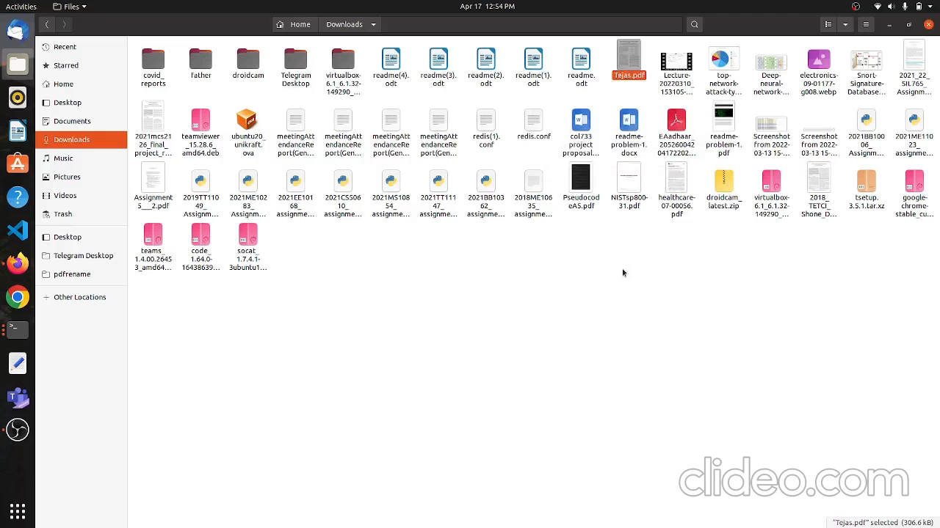
Video for Linux (Single file without proxy)

Slide 6

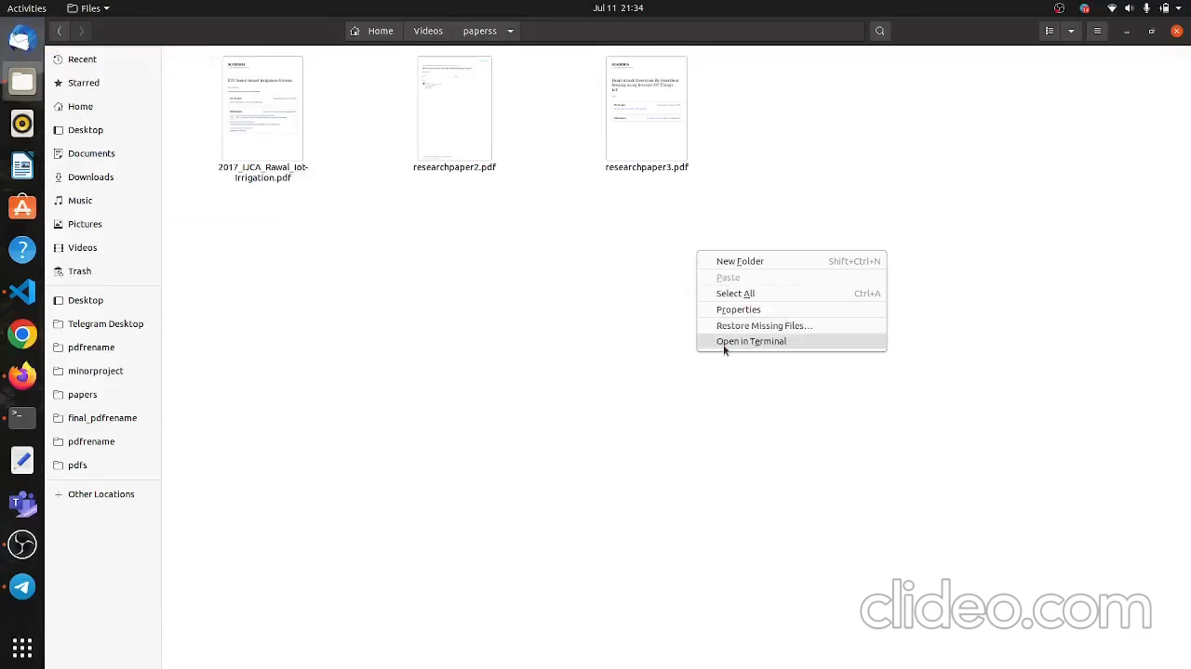
Video for Linux (single file with proxy)
We can only perform renaming just 2-3 times

Slide 7
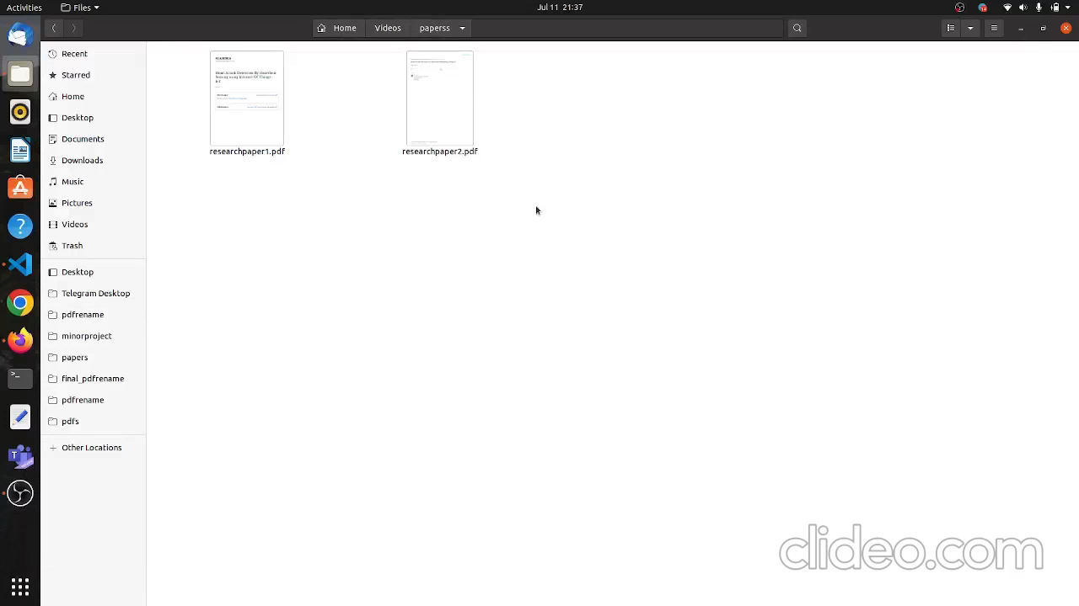
Video for Linux (Multiple Files)
The application will work even in the presence of other files or folders such as mp4, .zip, etc.

Slide 8
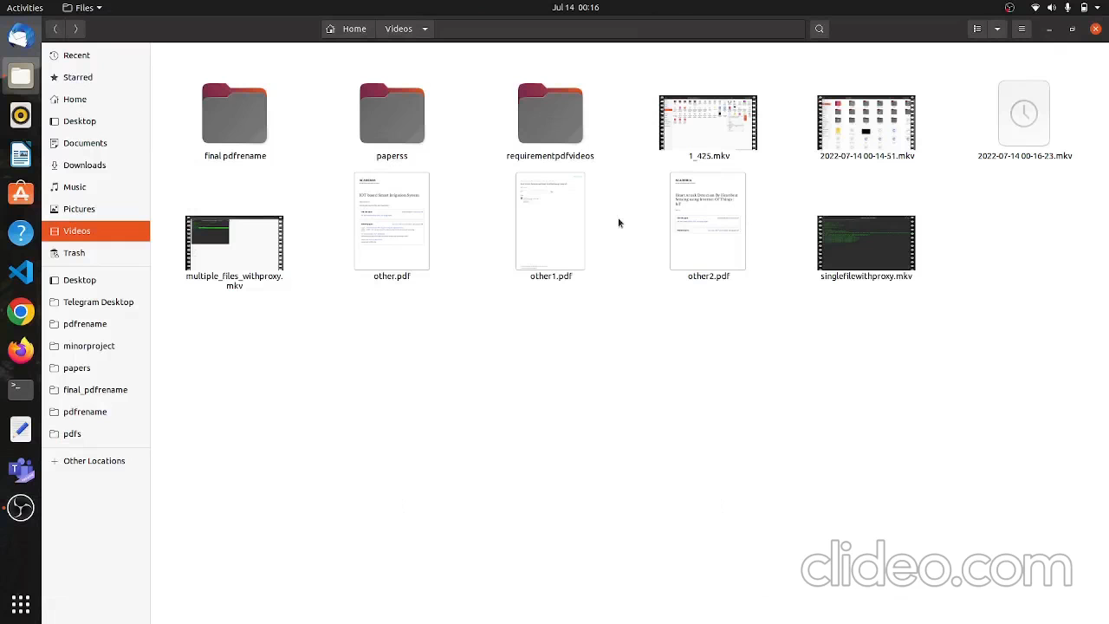
Video for Linux(Multiple files without proxy)

Slide 9
Windows

Slide 10
Windows Frontend Design Steps
Build an java application using core java code in NetBeans
Designed Frontend
Launch 4J to build the executable file
INNO setup for building the installer
File chooser cmd -> For command line arguments and right click context menu purpose.
List GUI to show saved proxy details
File Chooser Demo class for building desktop application by creating frames and dialogs.
Added appropriate frames and dialogs to take input from the user when he right click on the file.
Created a java list to save the proxy details and it takes saved details of the proxies from the file.
It renames the files with proxy by checking proxy connection.
Proxy connection
proxy connection class will set the proxy settings of the system and then checks whether the proxy is connected or not.
After checking proxy connection , if the proxy details are not present in the list , they will be added to the file which stores the saved details of the proxies.
Connected java front end to the core java application and made it working perfect for renaming files.
Added error messages for every case and the program will not crash at any point of time.
Added application to the right click menu by modifying the registry entry by writing the registry script in the installation script.
Added application in the “sendto” of the context menu so that multiple files renaming will be done using right click.
Renaming files without proxy by connecting to java main executable file.

Slide 11
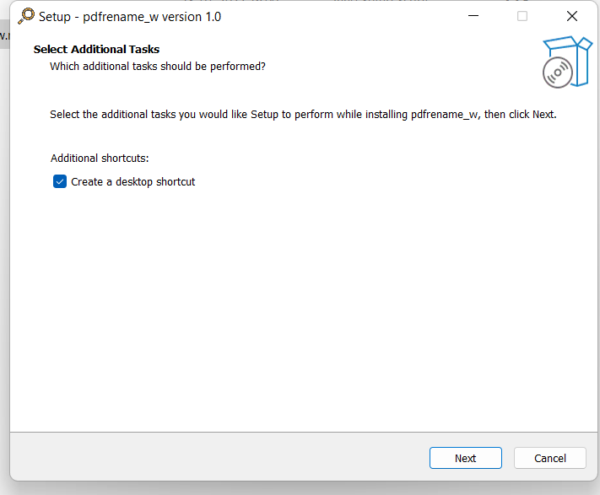
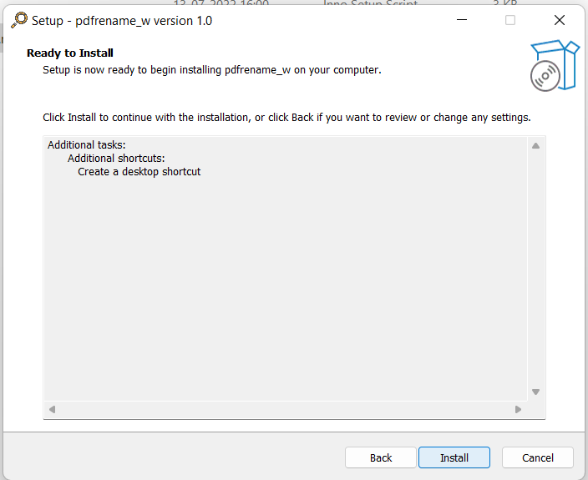
Screenshots of Installation

Slide 12
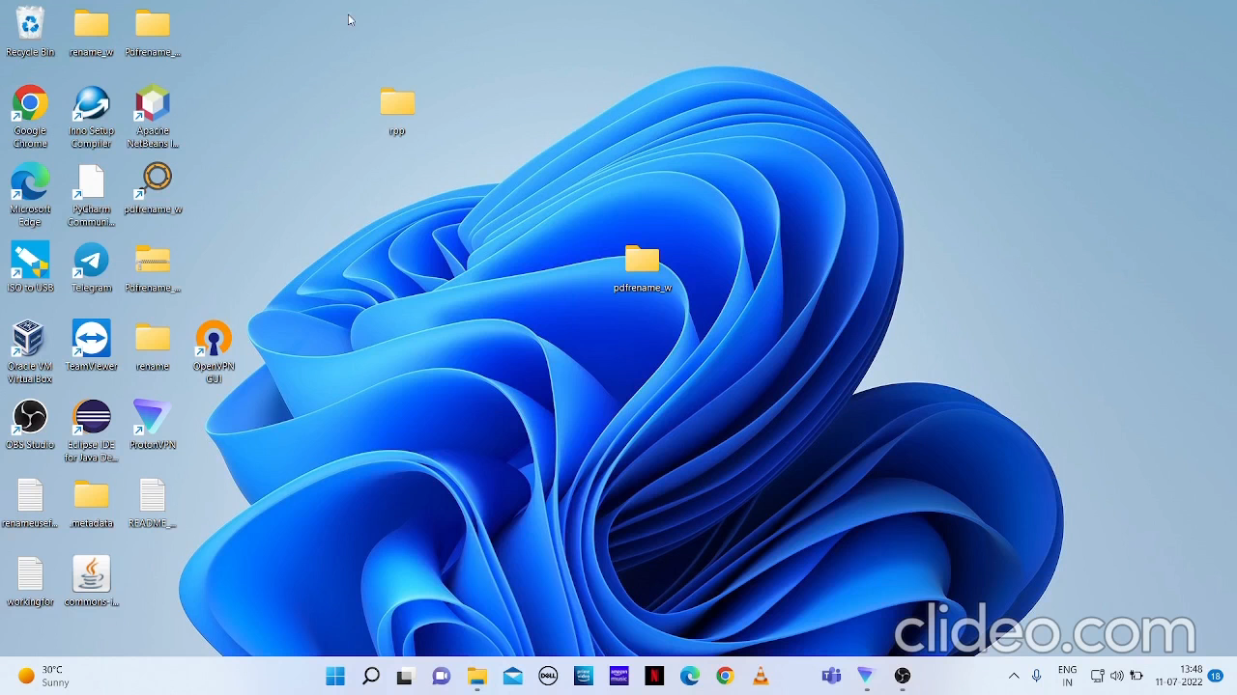
Video for Windows Installation

Slide 13

Video for Windows (single file with proxy)

Slide 14

Video for Windows (without proxy)

Slide 15
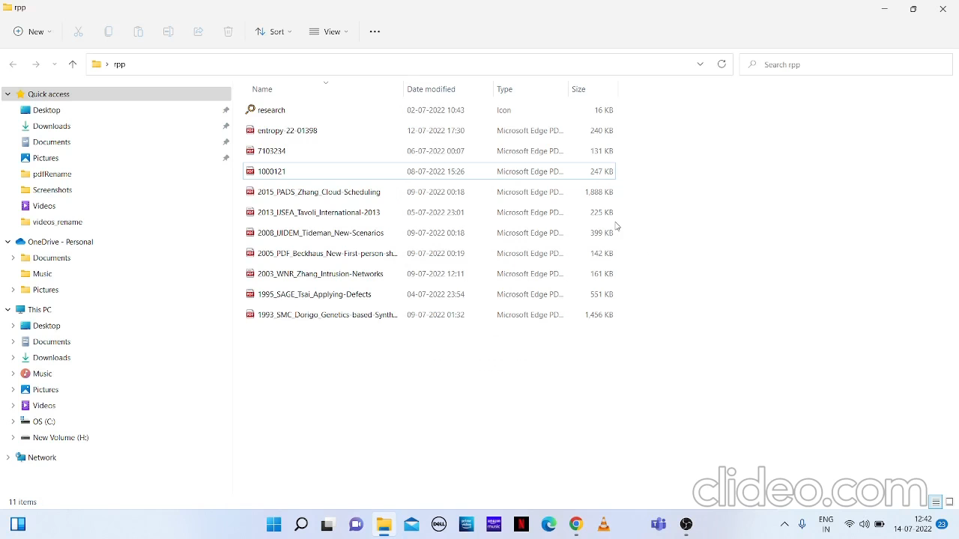
Video for Windows (Multiple Files With Proxy)

Slide 16
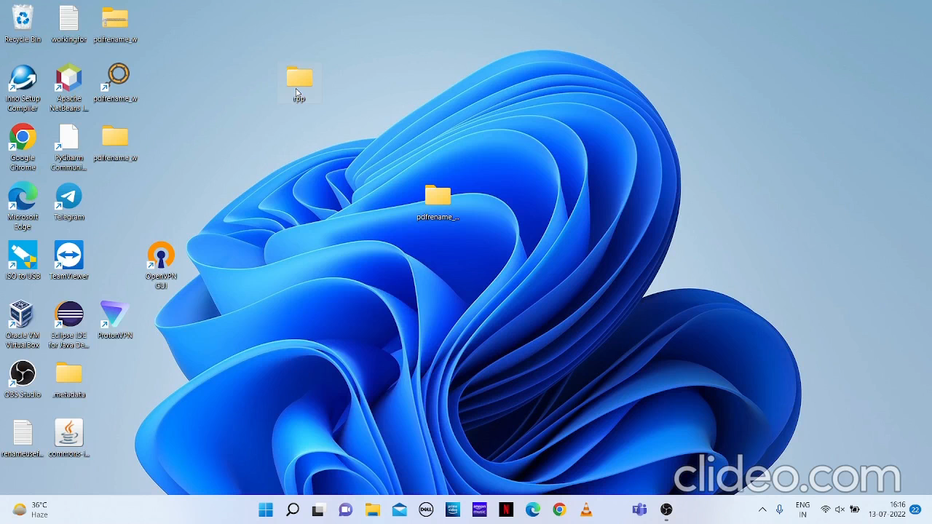
Desktop Application Renaming Multiple Files

Slide 17
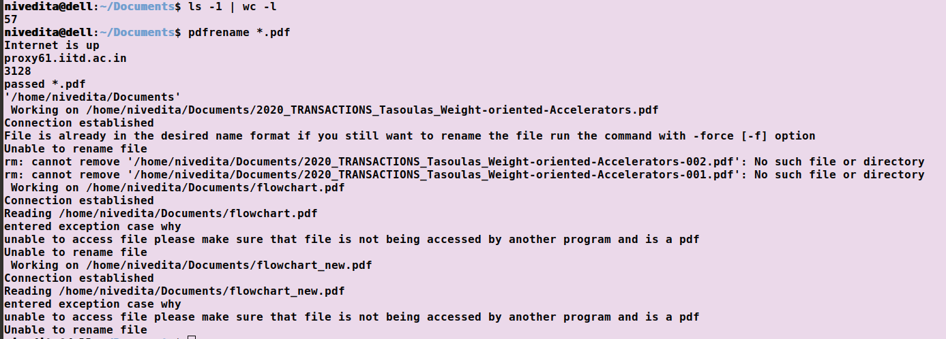
Verified: Working for Multiple Files for Linux (with proxy)

Slide 18
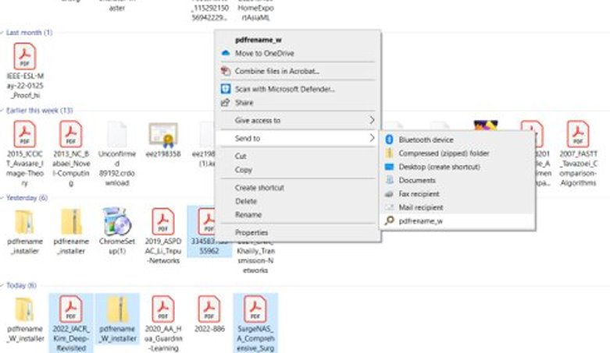
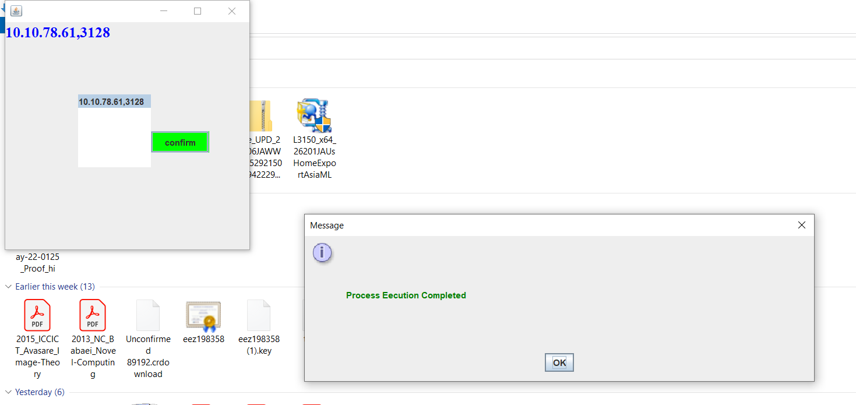
Verified: Working for Multiple Files in Windows (with proxy)

Slide 19
Exception (only in Windows)
I cant able to add pdfrename to right click context menu for multiple files but I added it to the “sendto” option in the right click menu which works fine for both single and multiple files. This is because of the simultaneous execution of the executable by taking each command line argument at a time.
The program will terminate when it is renaming incorrectly. It will not move onto the next file when multiple files given. This is because the incorrect renaming is happening at the end of the program execution.

Slide 20
Code
Github Link: https://github.com/nivi1501/pdfRename

Slide 21
References
https://docs.oracle.com/javase/tutorial/uiswing//components/filechooser.html
https://sourceforge.net/projects/launch4j/files/launch4j-3/3.14/
https://jrsoftware.org/isinfo.php
https://www.geeksforgeeks.org/setting-up-proxy-connection-to-a-system-in-java/

Slide 22

Thank You

